Slide 1

Guyana’s Climate
Equatorial climate that is characterized by seasonal rainfall, high humidity and small variations in temperature
Generally two rainy seasons and two dry seasons
Notes:
Equatorial climate that is characterized by seasonal rainfall, high humidity and small variations temperature
Rainfall variability is the dominant characteristic of climate in Guyana

Slide 2
2008 systems
Inter Tropical Convergence Zone
La Niña persisted until mid 2008– resulting intense rainfall and flooding in some areas
Tropical waves and troughs also contribute to intense rainfall in Guyana

Slide 4


Slide 5
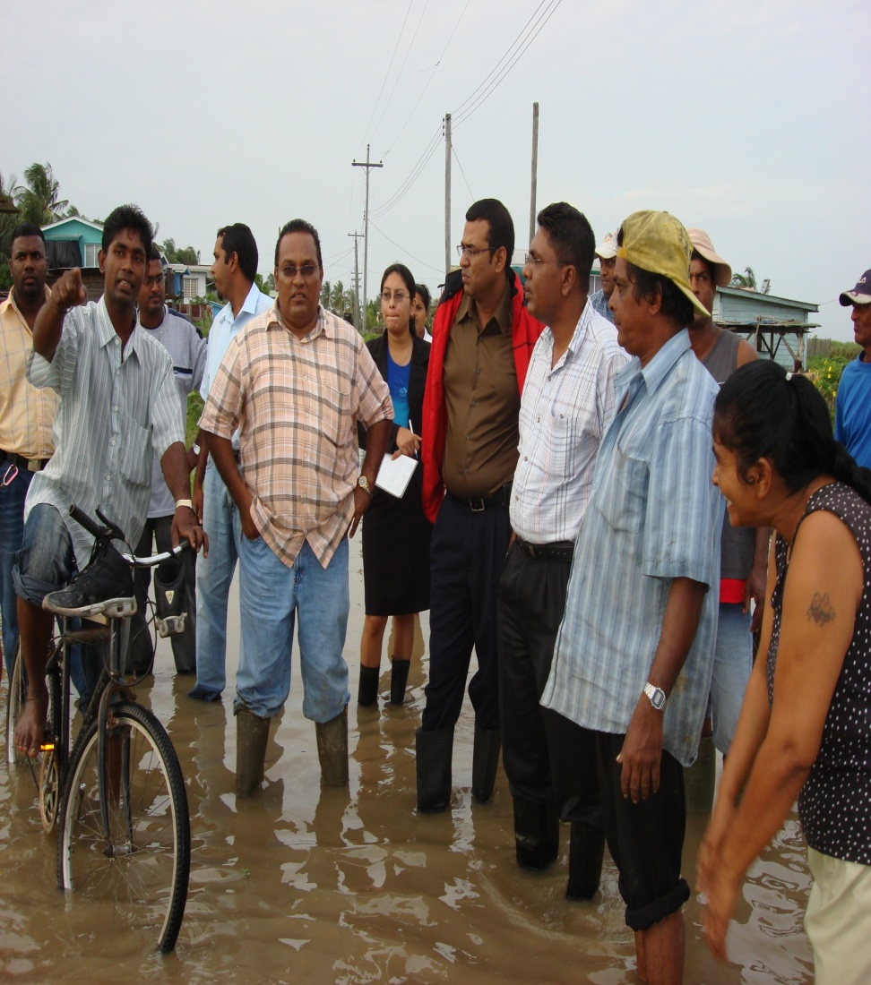
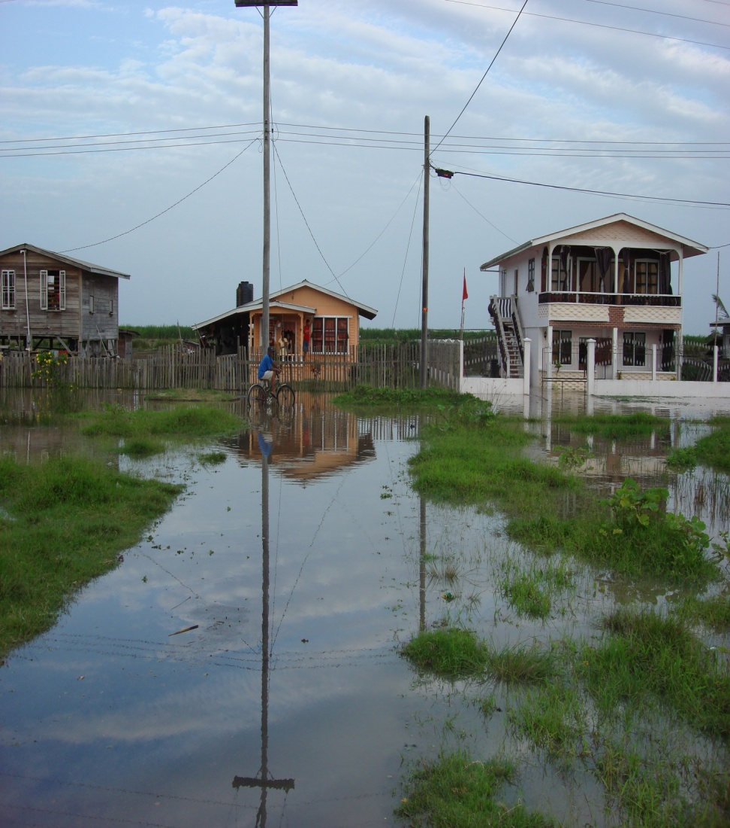
Floods in Berbice during Feb 2008

Slide 6
March 2008 rains

Slide 7



21st March 2008 – Overtopping of Sea Wall

