Slide 1
2021 MEETING OF DIRECTORS OF METEOROLOGICAL SERVICES
Document 4
OPERATIONAL MATTERS

Slide 2
Retirement of the Annual Integrated World Weather Watch Monitoring
The Commission for Observation, Infrastructure and Information Systems (INFCOM) at the third part of its first session (12-16 April 2021) produced an information paper on WMO Information System (WIS) Monitoring Procedures and Metadata Quality Indicators.
IWM and WDQMS were providing similar statistics of observational data.
INFCOM reviewed and decided inter alia:
(1) To suspend the operation of the Integrated World Weather Watch Monitoring (IWM) and to adopt the WMO Integrated Global Observing System (WIGOS) Data Quality Monitoring System as operational replacement;

Slide 3
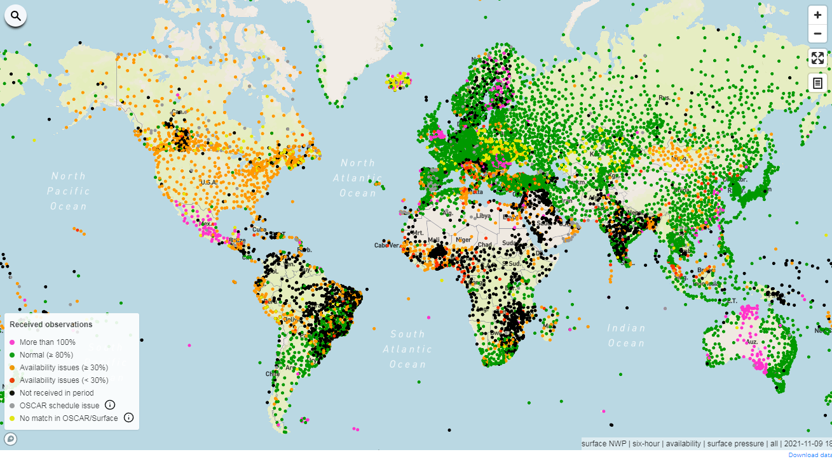

Slide 4
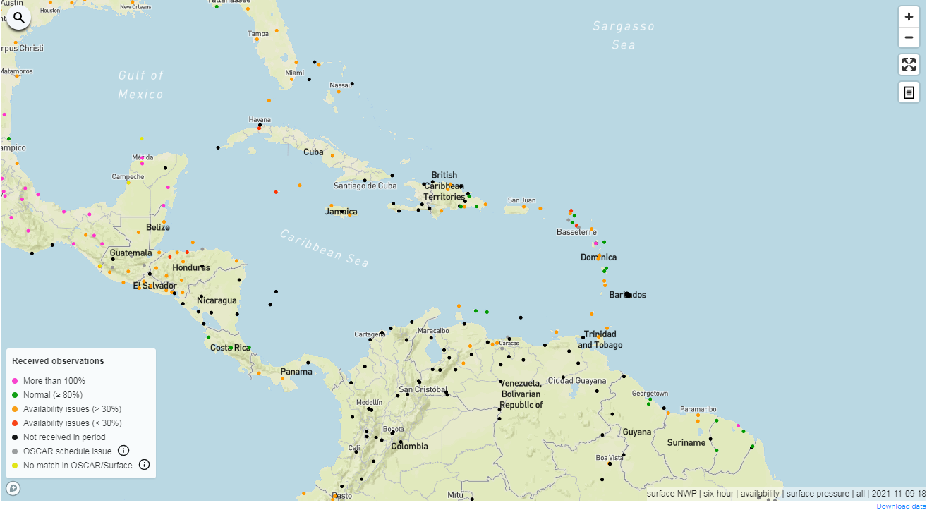

Slide 5
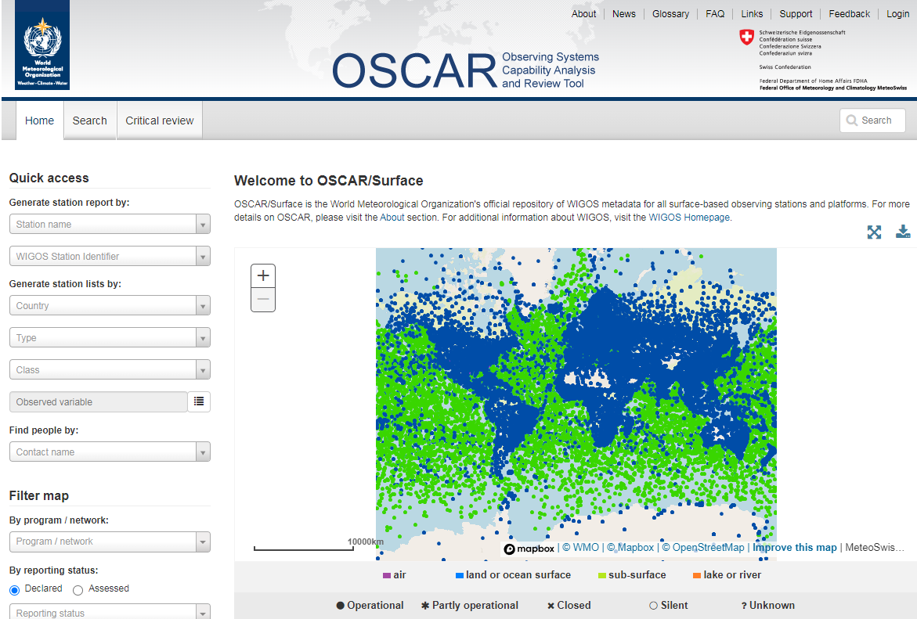

Slide 6
Websites to Note
WDQMS
OSCAR/Surface
WIGOS Station Identifiers
WIGOS Learning Portal : First time users will need to create an account using the self enrolment link.

Slide 7
Providing Impact-based Forecast and Warning Services through the Common Alerting Protocol (CAP) standard
The 18th Session of Regional Association IV (RA IV) decided in regards to "Providing Impact-based Forecast and Warning Services to stakeholders through the Common Alerting Protocol (CAP) standard":-
  To endorse the implementation of Impact-based Forecast and Warning Services (IBFWS) by Members through formal engagement with Disaster Management and Civil Protection Authorities (DMCPAs) and other stakeholders;
  To adopt the CAP standard for the dissemination of warnings to the stakeholders, as a significant step in the implementation of the Global Multi-hazard Alert System (GMAS) framework in the Region;

Slide 8
Regional Basic Observing Network (RBON)and Global Basic Observing Network (GBON)
The Regional Basic Synoptic Network (RBSN) and Regional Basic Climatological Network (RBCN), will become a major part of the Regional Basic Observing Network, which will replace the RBSN and RBCN.
Global Numerical Weather Prediction (NWP) and climate reanalysis, depend on access to globally consistent sets of observations provided by surface- and space-based observing systems.
In order to ensure that observational requirements for Global NWP and climate reanalysis are met more effectively, a new approach is essential to support these applications. The new approach is the Global Basic Observing Network or GBON

Slide 9
QUESTIONS?

