Slide 1
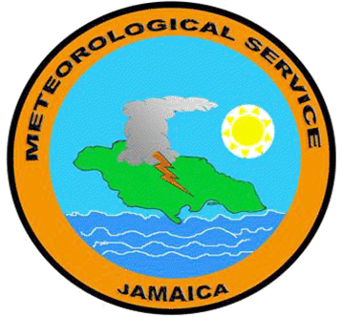

2021
Weather Impacts on Jamaica
Evan Thompson
Director
Meteorological service
JAMAICA

Slide 2
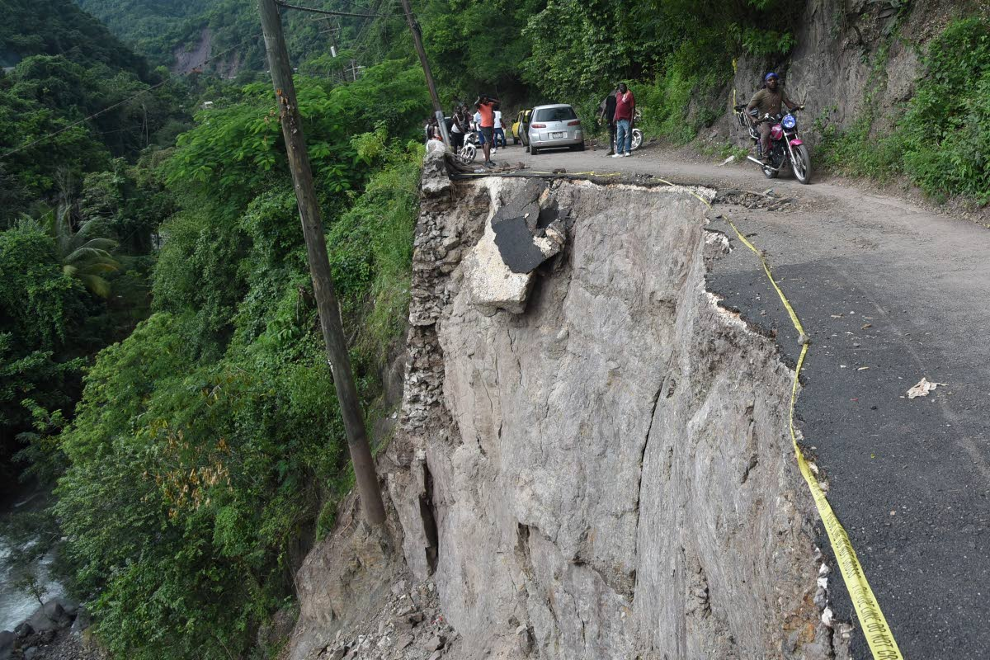
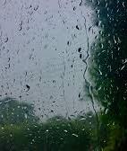
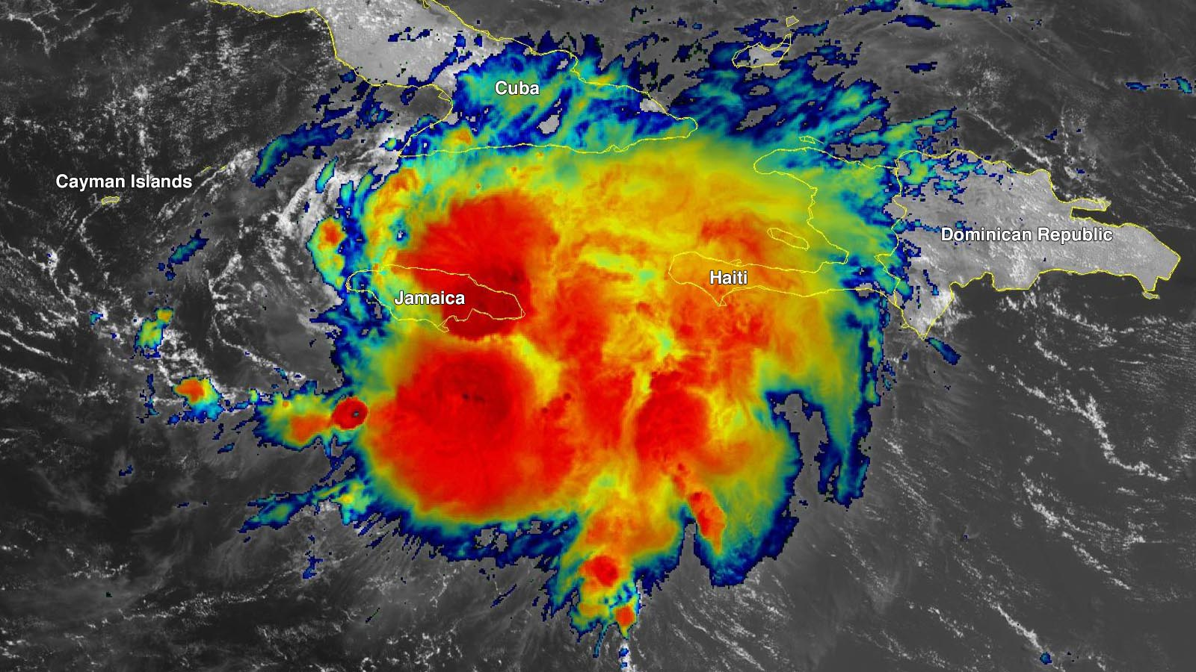
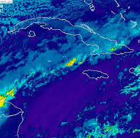
Weather Features
Tropical Waves
Tropical Cyclones
Frontal Systems
Severe Thunderstorms

Slide 3
Upper-Level Trough
January 8-9
Trough extending over Cuba and Jamaica produced flooding in a number of communities of Montego Bay

Slide 4
Quasi-Stationary Front
February 4-5
Located just east of Jamaica, the Frontal System produced overnight rains lasting more than 13 hours in some areas in the northeast of the island.
Flooding was reported across Portland and the Caneside and Little Annotto Rivers overflowed their banks.

Slide 5
Tropical Wave
June 28-29
A combination of a tropical wave and an upper-level trough produced several hours of rainfall over western parishes and led to a massive landslide.

Slide 6
Tropical Storm Elsa
July 3-4
The centre of Elsa passed east and north of Jamaica and was just 40km off the northeast coast on July 4.
Several hours of continuous rainfall started on the night of July 3 and continued all day on the 4th, resulting in floods in several communities of St Thomas, Kingston, St Andrew, St Catherine and Clarendon.

Slide 7
Upper-Level Trough
July 25 and 27
News reports indicated that a “freak storm” affected a community in St Elizabeth destroying crops and roofing on the 25th.
Another similar event on the 27th produced heavy thunderstorms downing trees and power lines in the same parish.

Slide 8
Tropical Storm Grace
August 17
The centre of the tropical cyclone moved across the island from east to west bringing tropical storm conditions.
Flooding was reported of in all parishes and landslides, downed trees, downed power lines and electrical outages were also reported in several parishes.
The meteorological radar was effective in pinpointing the location of the centre of Grace as it moved across the island, which was very useful to the NHC.
The highest 24 hour period of rainfall total of 357.5 mm was recorded at Bois Content in St. Catherine on August 17, 2021.
Mona recorded the highest wind gust of 81 km/h.
The lowest QNH was 1007.24 millibars.

Slide 9
Tropical Storm Ida
August 26-27
Area of Low Pressure, associated with tropical wave, developed into Tropical Depression #9 on August 26 while 190km SSW of Jamaica.
Tropical Storm Ida formed later in the afternoon about 160 km from westernmost point of island.
Rainfall affected several parishes with flooding and landslides. The Rio Cobre overflowed its banks and numerous roads across the island were blocked by landslides.
One loss of life.

Slide 10
Surface Trough
October 2
Hailstorm reported in Kingston Metropolitan Region on September 30.
Located just west of Jamaica, the trough generated thunderstorms that caused heavy rains and strong winds that removed roofs within a 15-minute period in St Catherine.
Downed trees resulted in blocked roadways and loss of electricity.

Slide 11
Quasi-Stationary Front
November 8
The Frontal System located just west of the island produced overnight and morning rain over mainly western parishes.
Heavy rainfall resulted in severe flooding in sections of Montego Bay and its environs.
Mean Rainfall for November – 101.8mm
Rainfall on November 8, 2021 – 157.3mm

Slide 12
Thank you
Evan Thompson
Director, Meteorological Service
JAMAICA

